Slide 1

DCC PROGRAMMING
You’ve got the decoder installed, now to program it.

Slide 2
What is DCC Programming?
Gives each locomotive individual traits
Allows special lighting effects
Enables locomotives to be speed matched
Allows for custom sound profiles

Slide 3
What is Needed to Start Programming?
DCC system with appropriate throttle (DT400 Series)
OR
Computer with applicable interface device (PR3)
Isolated piece of track
Wires to connect track to programming device
Programming book that lists CVs.
PERSEVERANCE and PATIENCE

Slide 4
What are Configuration Variables(CVs)?
Control how decoder reacts to user inputs
Controls speed table:
How fast the locomotive moves at a certain setting on throttle
Controls functions:
If ditch lights flash with horn, to whether forward is actually forward

Slide 5
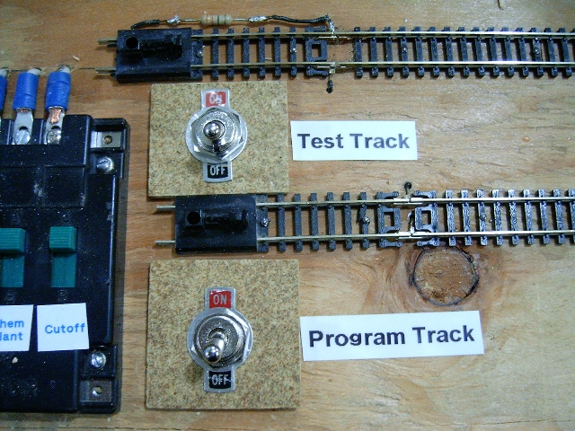
Programming Basics
How to assign an address and ensure forward is actually forward

Slide 6
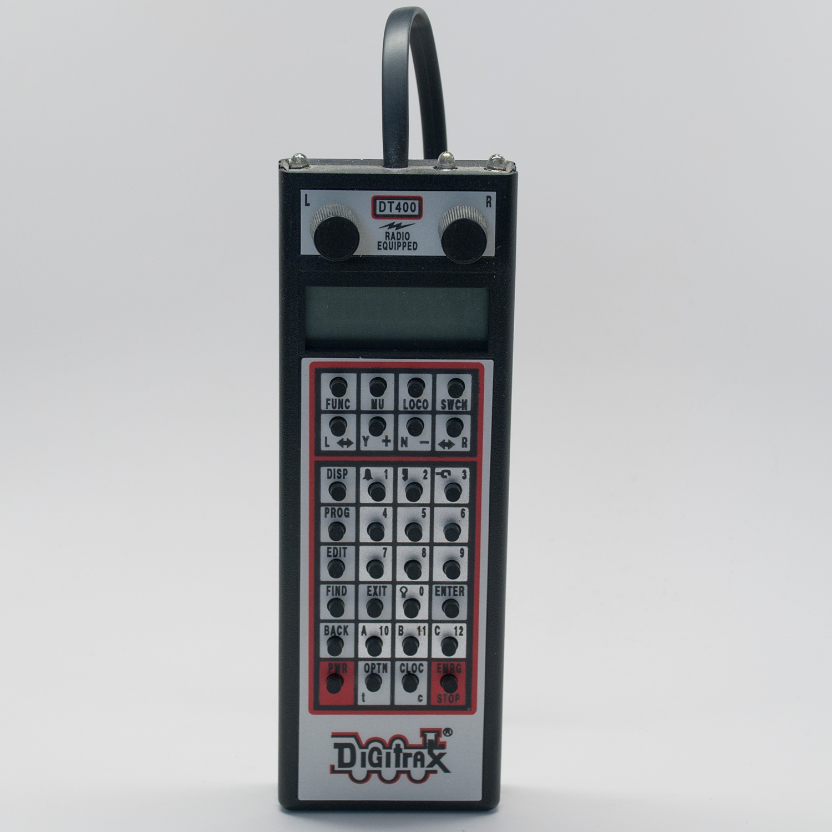
Assigning an Address on DT400
Press PROG button on the throttle
Wait until Ad2 =???? appears on screen
Click the Right Throttle Knob once
Ad4 =???? Should appear on screen
Use number pad to enter address
Press Enter
Ad4on?=y will appear on screen
Press Y + key once within 6secs
Press Exit button

Slide 7
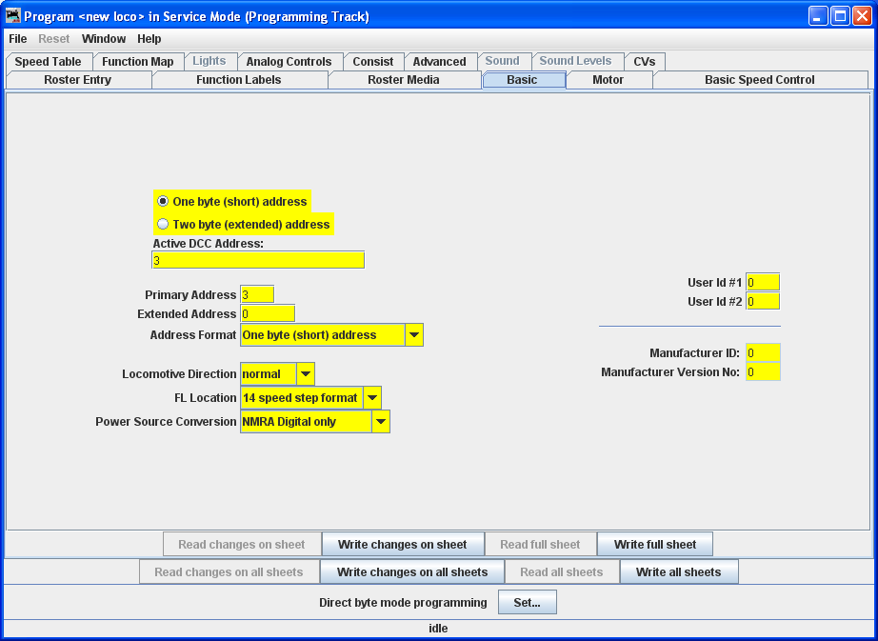
Assigning an Address in JMRI
Click New Loco button
Click Read Type from Decoder
Select decoder model from highlighted list
Click Open Comprehensive Programmer
Click Basic tab from the top selection
Click Read Full Sheet
All fields should turn white
Enter all desired settings
Click Write Full Sheet

Slide 8
What is CV29 and how to check it?
Informs the decoder about multiple items:
2 or 4 digit address assigned
Normal Direction of Travel (NDOT) Forward or Reverse
14 or 28/128 Speed Steps
Analog Conversion – allows DCC locos to run on DC layouts
If your loco is behaving strange……..
CHECK CV29
Default value is 38 once a 4 digit address is set

Slide 9
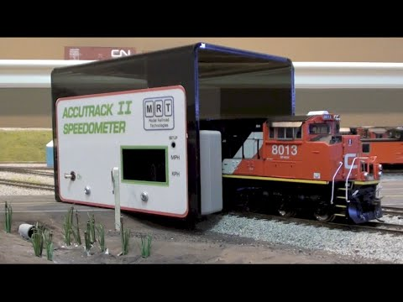
Speed Matching Basics
How to make multiple locomotives behave nicely together

Slide 10
What is Speed Matching?
Allows multiple locomotives from different manufacturers to be “consisted” together to run as a group.
Utilized by having each locomotive running approximately the same speed at each speed setting on the throttle.
Works by changing the amount of voltage going to the motor at each defined speed step on the decoder.

Slide 11
What is Needed to Speed Match?
Long straight section of parallel track (at least 7-8 feet)
Note pad and writing utensil
Programming track and equipment
LOTS OF PATIENCE AND PERSEVERANE (at least 2 hrs)
OR
Speed rollers on a programming track
Microsoft Excel, performing math calculations
LOTS OF PATIENCE AND PERSEVERANCE (at least 1.5 hrs)

Slide 12
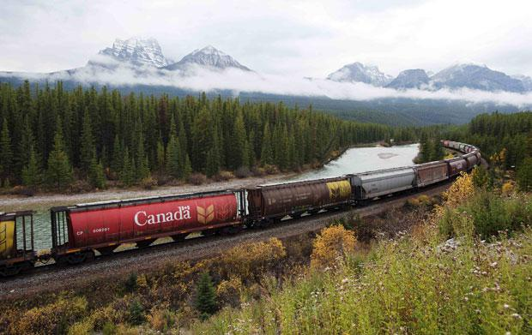
CONCERNS?
COMMENTS?
QUESTIONS?

